Slide 1

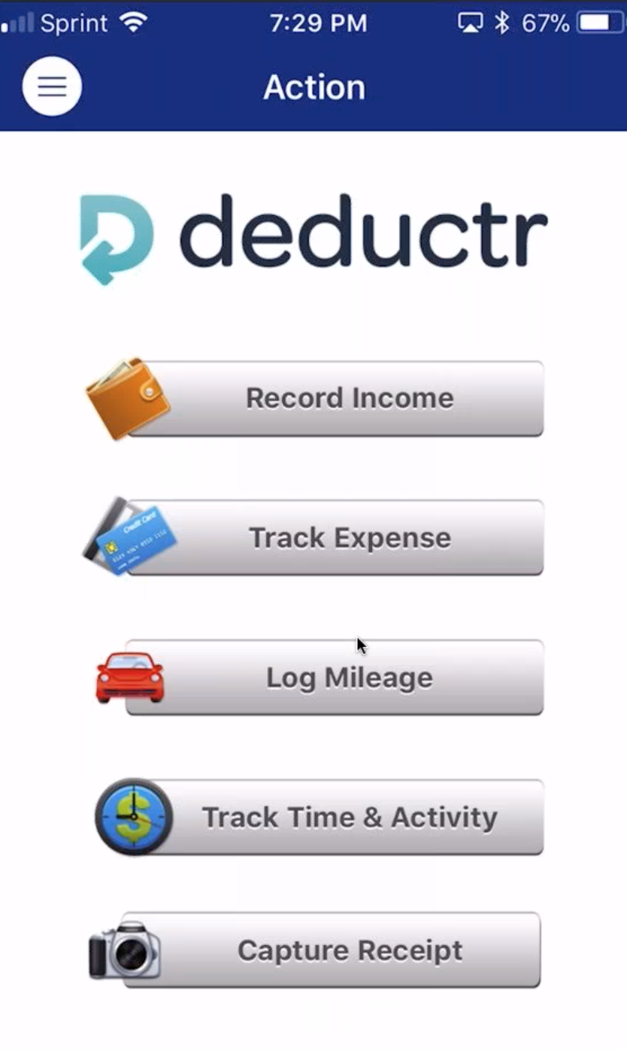
YOUR RESOURCES FOR TRACKING TAX EXPENSES &
SHOPPING ANNUITY SPENDING
FREE WITH UFMS
Week 1: Introduction to Deductr. Goal for the 4-week group
Week 2: Tips & Tricks. Featured guests and users
Week 3: Recruiting & Retention with Deductr
Week 4: Call to Action / Getting your team on board
Notes:
Track all expense with linked bank accounts, credit cards, track mileage with GPS on phone, take pictures of receipts etc

Slide 2

KEEP MORE OF WHAT YOU MAKE
The average small business owner leaves roughly $3,000 each year on the table, simply because they did not track, monitor and submit expenses they are entitled to write off of their taxable income.

Slide 3

TAX BENEFITS
Deductr is like having a personal assistant to track:
Business expenses
Mileage
Time without the salary.
For many UFOs, their UnFranchise Business is their first time owning a business. Deductr makes tax preparation easier for them by providing a simple system to keep them organized throughout the year so that they can have solid documentation and maximize their deductions

Slide 4
SHOPPING ANNUITY BENEFITS
Wouldn’t it be great if you could see your ACTUAL spending verses your STATED spending that you input into your SAA?
By classifying something as a Shopping Annuity Expense in Deductr you:
Verify your spending broken down into Assessment categories to see the true picture for how much you are actually spending.

Slide 5
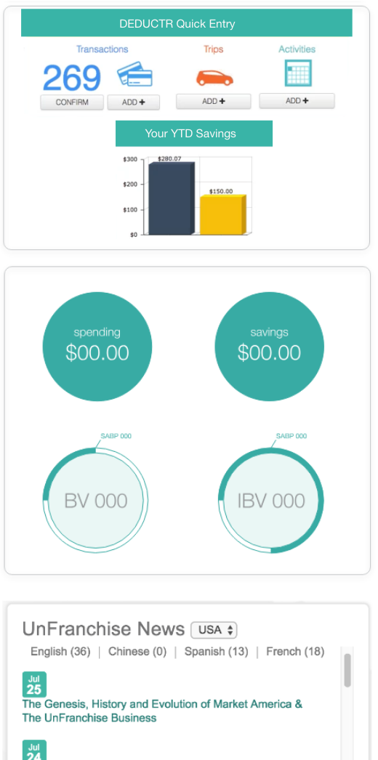
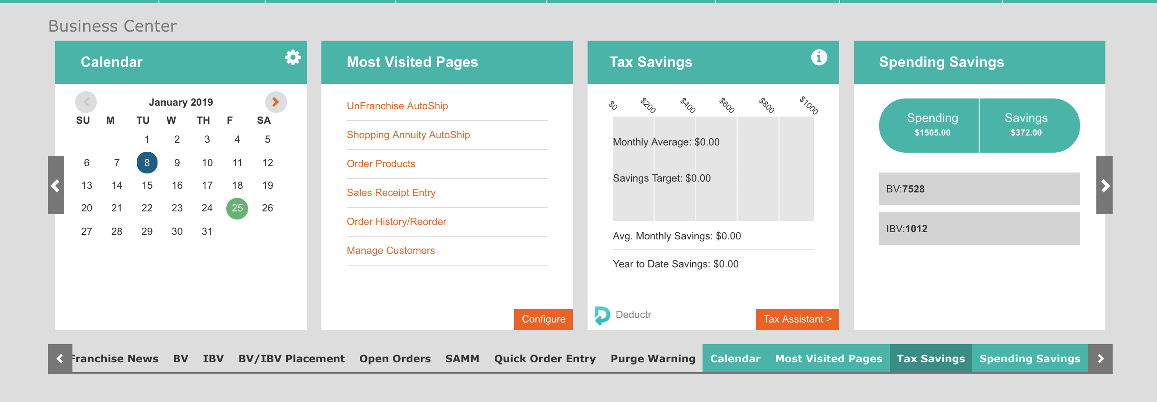
ACCESS DEDUCTR:
Login to UnFranchise
Business Center, Deductr
Set up your account
Download the app for mobile use (Make sure you
Login to UnFAutomated & Transparent! Happens as you live and spend and documents for Schedule C as an independent business person.
ACTIVATE YOUR ACCOUNT BY LOGGING INTO DEDUCTR ON UNFRANCHISE.COM
  Confirm your business expenses
  Confirm your actual SA spending
  Upload paper receipts
  Track your mileage
Notes:
Integrated in UF.COM, each time you go in you can monitor your savings and spending toward the Shopping Annuity.

Slide 6
LIVE DEMO

Slide 7

TIPS FOR CONSISTENCY
Pick a time that you can commit to logging in each DAY OR WEEK (Whichever you can ABSOLUTELY commit to)
  Deductr FRIDAYS
  With Morning Coffee
  Or after dinner
Start the habit of turning on mileage tracker when you take business trips (You need the app to do this)

Slide 8
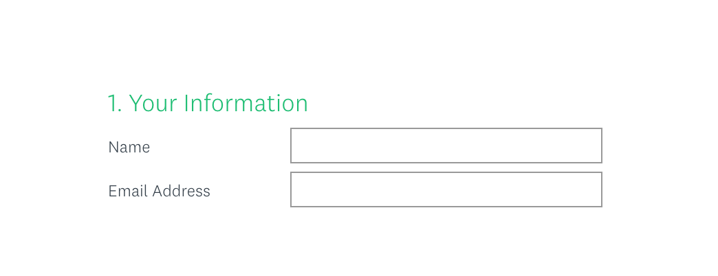
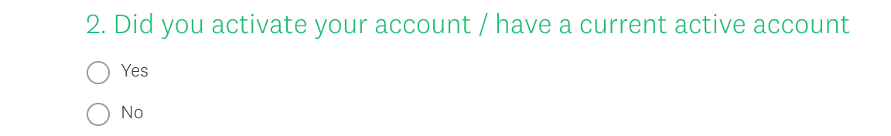

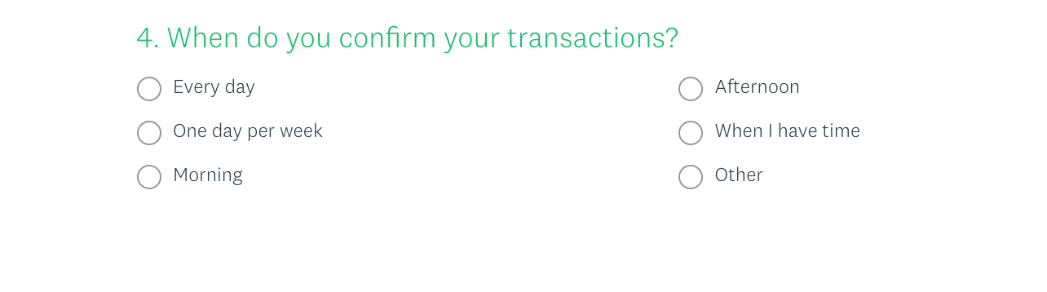
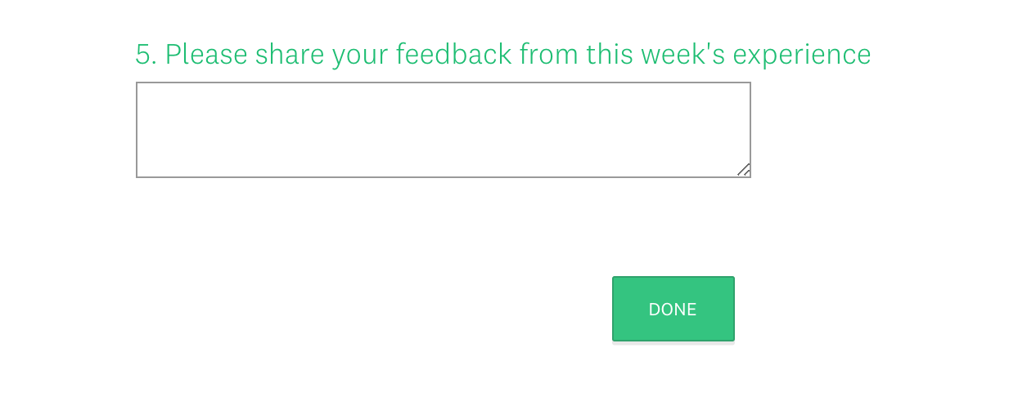
SUBMIT RESPONSES EACH FRIDAY, 11:59 PM.
https://www.surveymonkey.com/r/Deductr
MAKE DEDUTR A HABIT THIS WEEK!
Activate & Setup your account
Confirm tax expenses for Jan 1, 2019 – Current
Categorize your SA spending
Add mileage
Submit your accountability on Friday

Slide 9
YOUR RESOURCES FOR TRACKING TAX EXPENSES &
SHOPPING ANNUITY SPENDING
FREE WITH UFMS
Week 1: Introduction to Deductr. Goal for the 4-week group
Week 2: Tips & Tricks. Featured guests and users
Week 3: Recruiting & Retention with Deductr
Week 4: Call to Action / Getting your team on board
Notes:
Track all expense with linked bank accounts, credit cards, track mileage with GPS on phone, take pictures of receipts etc

Slide 10
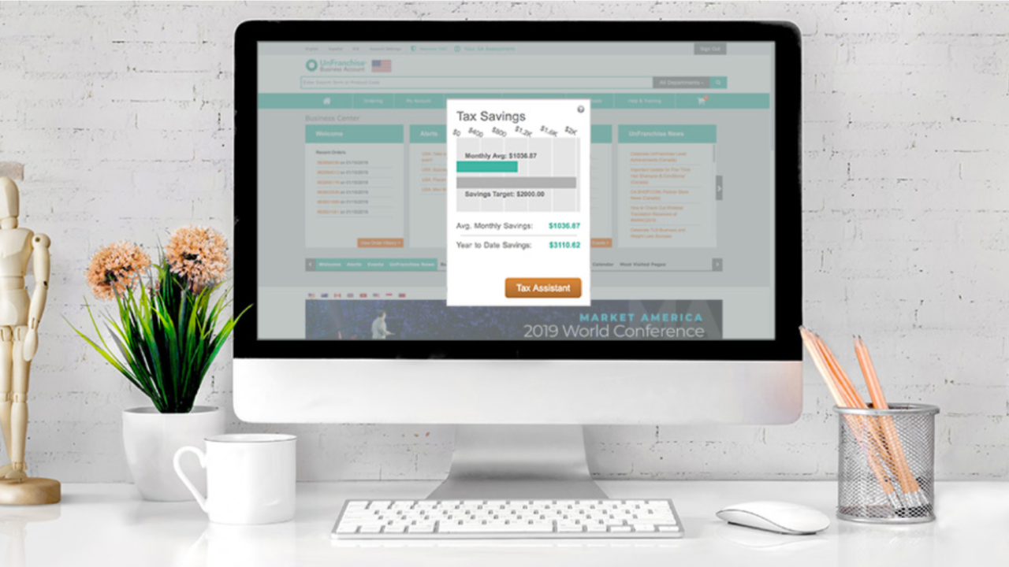
TOP QUESTIONS FROM WEEK 1:
My bank does not come up? What should I do?
Can I link a credit card?
Can I enter manually? (For non-bank accounts)
How to use app / login using Deductr?
Can I track more than one business?
SA Spending verses Tax Expenses?
How to record SA Spending?
Where do you record Autoship expenses?
Where should I go for FAQs and ongoing support?

Slide 11
SUBMIT RESPONSES EACH FRIDAY, 11:59 PM.
To Do:
Confirm your expenses the week
Categorize your SA spending
Add mileage
Submit your accountability on Friday
Access your Deductr Account / Check out Help Center
Adjust one thing that did not work for you this past week ☺
https://www.surveymonkey.com/r/Deductr

